Slide 1
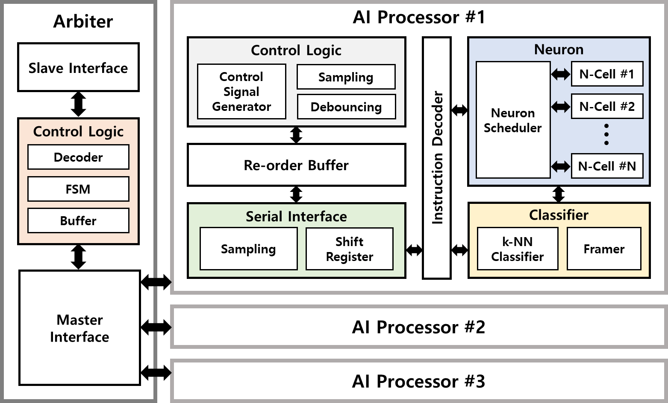
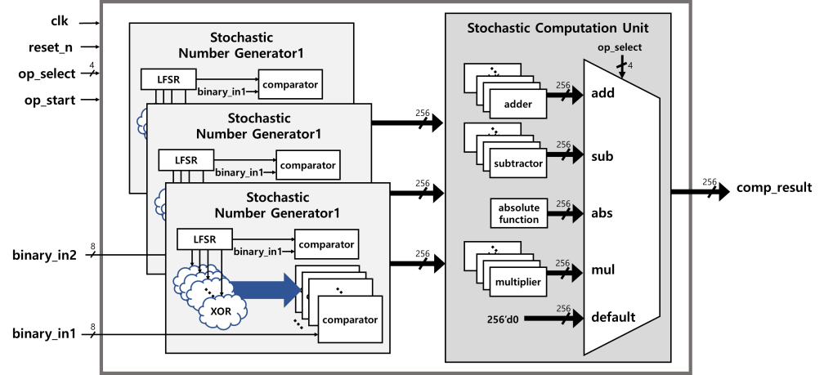
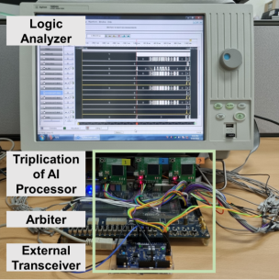
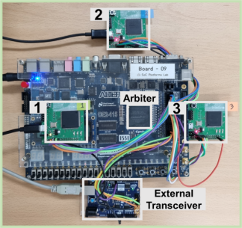



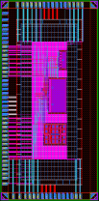
Research Interests
Stochastic computing
Resilient architecture
Balance the tradeoffs between accuracy and energy efficiency
Low-power and resilient architecture and chip design
1

Slide 2
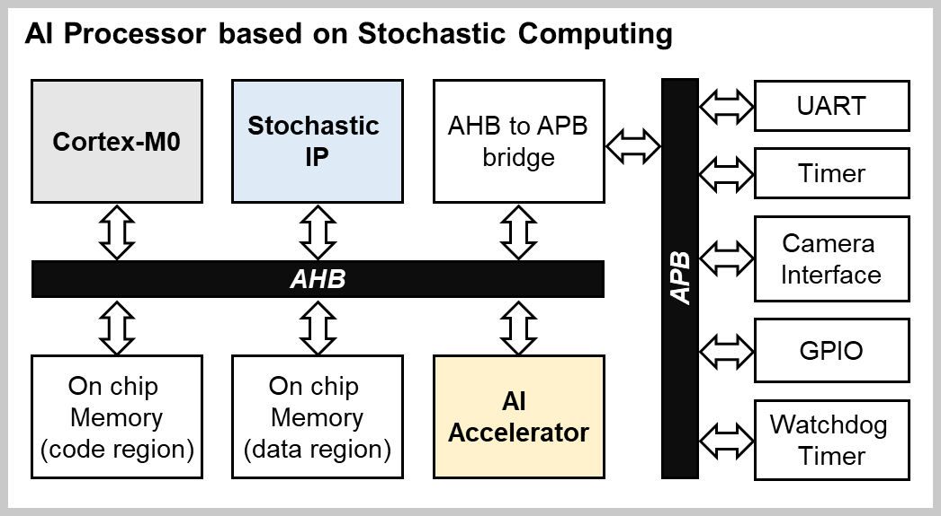
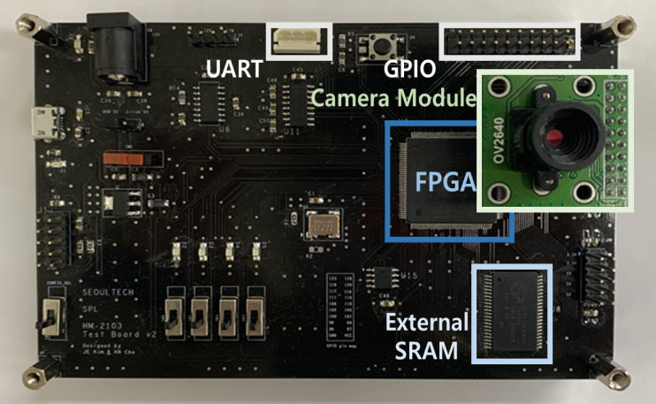



Stochastic Computing
Embedded AI Processor
Processor Architecture
Core | Arm Cortex-M0
Operation Freq. | 50MHz
Memory | Code : 16KB, Data : 128KB
Interface | AHB, APB
Stochastic IP | Accuracy: 92.4%
AI Accelerator | k-NN algorithm
Peripheral | Camera I/F, Serial I/F, GPIO, Timer
[Overview of a Processor based on SC]
[Original Image]
[Deterministic Implementation]
[Stochastic Implementation]
[Verification Prototype]
2

Slide 3
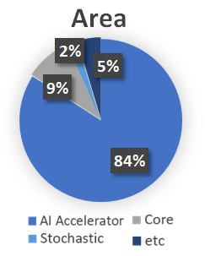
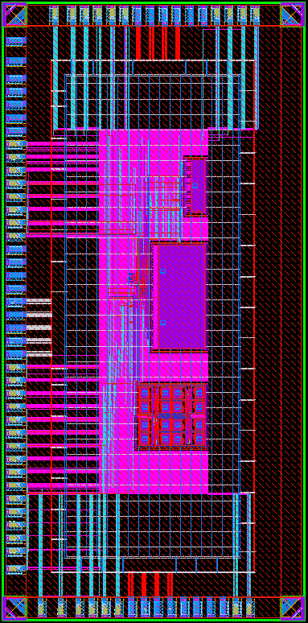
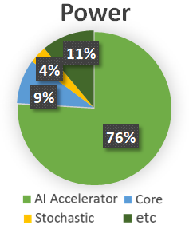
Stochastic Computing
ASIC Design
 | Specifications
Technology | Samsung 28nm CMOS
Operation Power | Core: 1.0V
 | IO: 1.8V
Operation Frequency | 50MHz
Gate Counts | 1062K @ 50MHz
Operation Specification | Operation Temp: -40°C~125°C
 | Core Voltage: 0.9V~1.1V
Memory | code region: 16KB
 | data region: 128KB
 | AI Accelerator: 1KB
Peripherals | Camera I/F, UART, GPIO, Timer
Interface | AHB, APB
Dimension | 2mm × 4mm
Code mem.
Data mem.
AI Acc.
[Chip Layout]
3

Slide 4


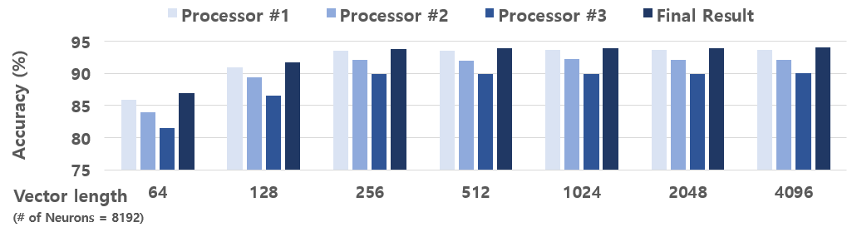
Resilient Architecture
An Architecture for Resilient Federated Learning
[Proposed Architecture]
[FPGA Implementation]
[Accuracy improvements (2.3% on average)]
4

Slide 5
Appendix
5

Slide 6
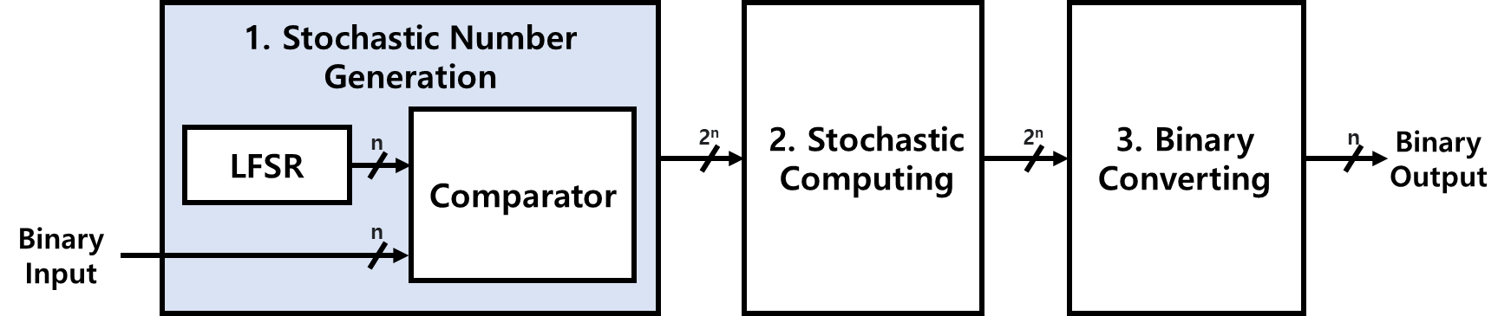
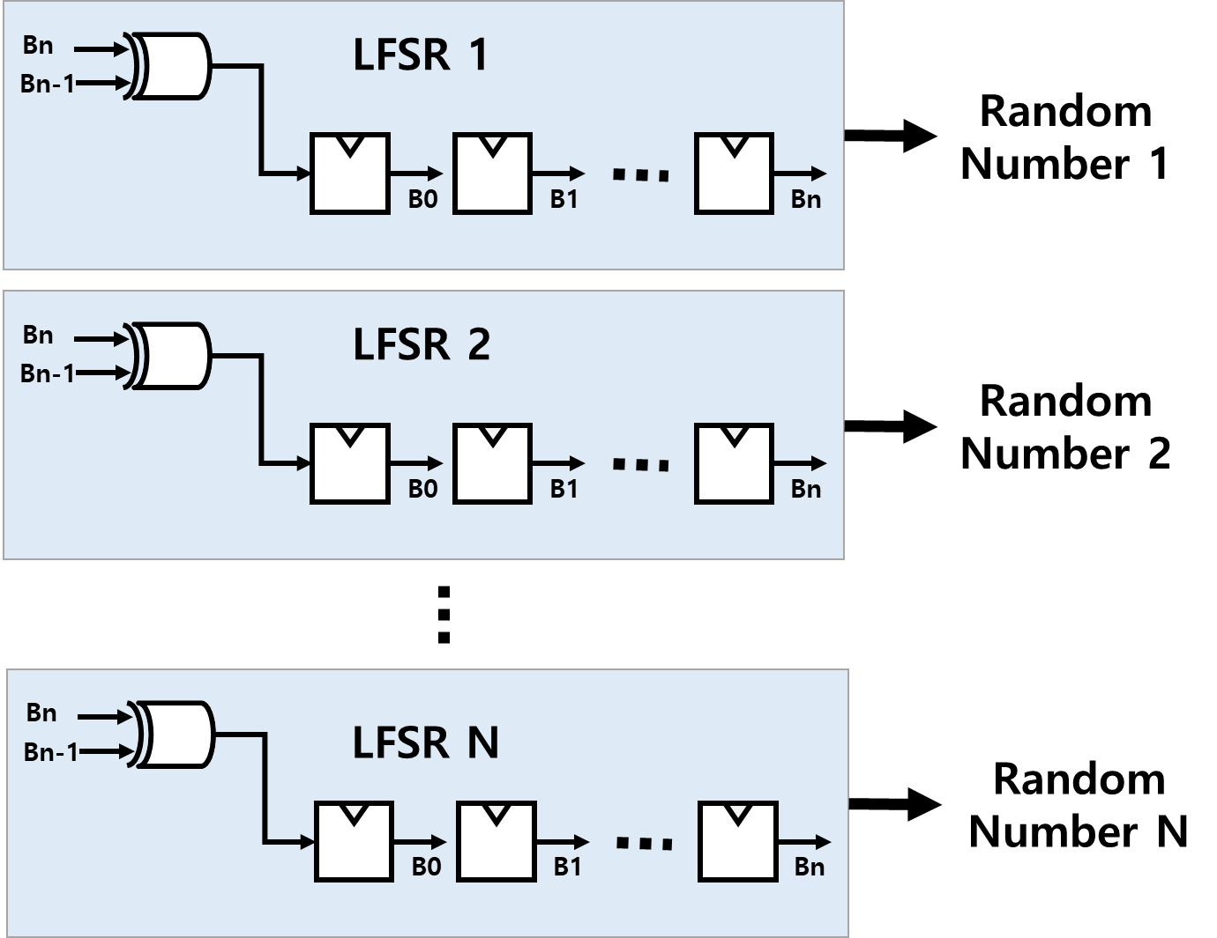
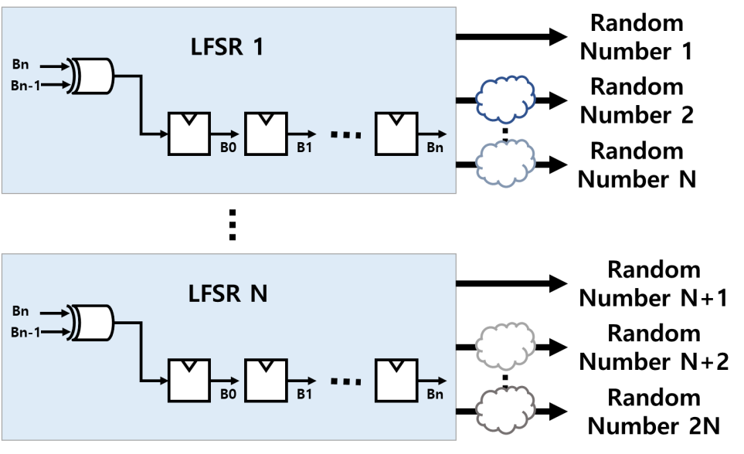
Parallel Stochastic Computing
Goal: Reduce the latency to generate stochastic sequence!
[Multiple LFSRs]
[Shared LFSRs]
Pro: High frequency
Con: Area overhead
Pro: Reduced Area
Con: High Dependency

Slide 7
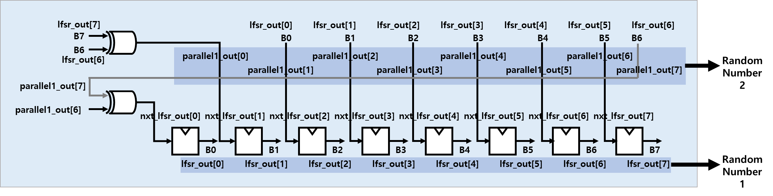
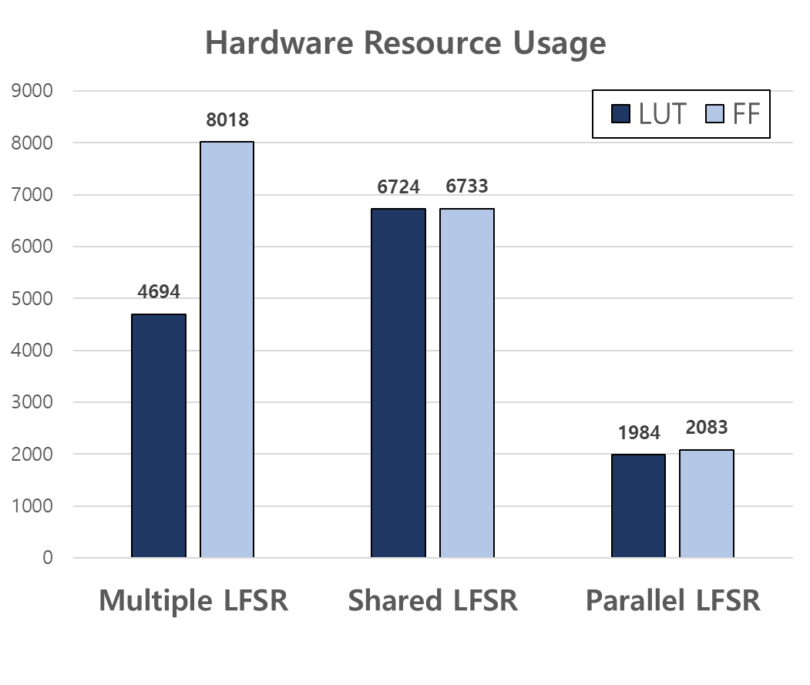
Stochastic Computing
Parallel Stochastic Computing
Pro: Area efficiency
Con: High frequency
Parallel LFSR [1]
Hardware efficiency
[Hardware Resource Usage]
 | Multiple |  | Shared |  | Parallel
 | LUT | FF | LUT | FF | LUT | FF
SNG ⅹ3 | 3277 | 6529 | 5281 | 5407 | 1141 | 1183
SC circuits | 630 | 680 | 697 | 558 | 188 | 223
Binary Converter | 787 | 809 | 746 | 768 | 655 | 677
Sum | 4694 | 8018 | 6724 | 6733 | 1984 | 2083
[1] Ekaterina LASKIN. (2006). “ON-CHIP SELF-TEST CIRCUIT BLOCKS FOR HIGH-SPEED APPLICATIONS”, Master Thesis, University of Toronto, p. 102.
7

Slide 8
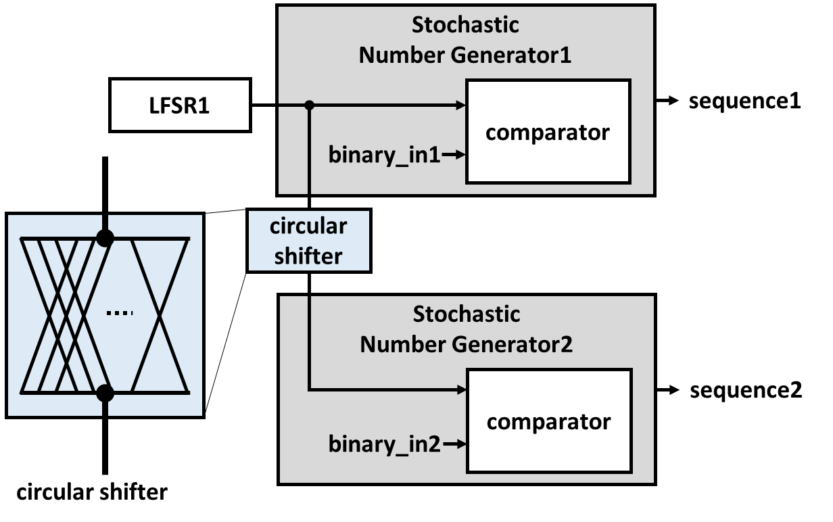
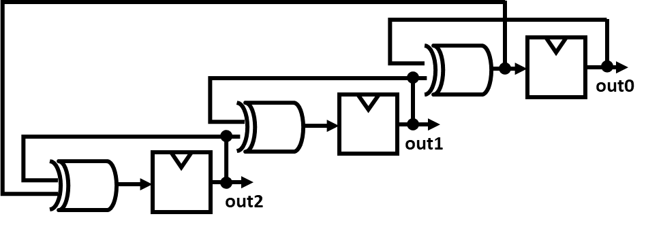
Related works
Shared LFSR
Parallel LFSR
 | Out2 | Out1 | Out0
Clock1 | 7 | 4 | 1
Clock2 | 8 | 5 | 2
Clock3 | 9 | 6 | 3
[Stochastic number generation employing shared LFSR [2]]
[Parallel LFSR [1]]
[1] M. Tawada and N. Togawa, "Designing Stochastic Number Generators Sharing a Random Number Source based on the Randomization Function," 2020 18th IEEE International New Circuits and Systems Conference (NEWCAS), 2020, pp. 271-274.
[2] Ekaterina LASKIN. (2006). “ON-CHIP SELF-TEST CIRCUIT BLOCKS FOR HIGH-SPEED APPLICATIONS”, Master Thesis, University of Toronto, p. 102.

Slide 9
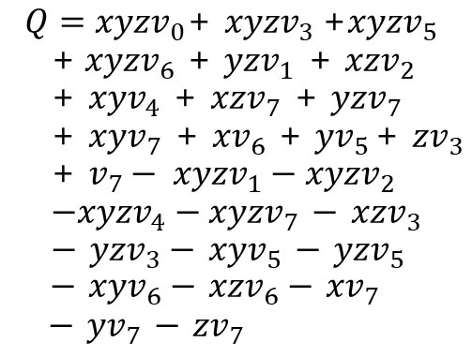
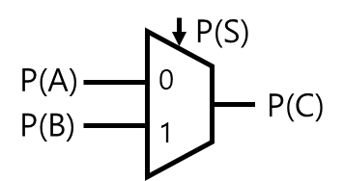
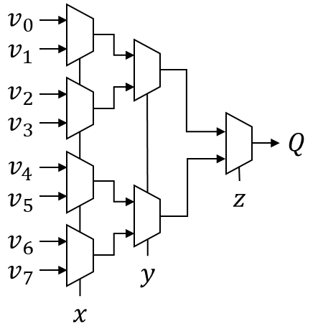
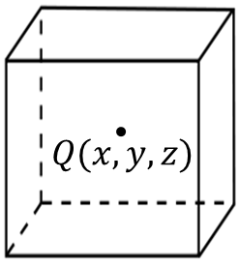
Introduction – Benefits
Area Efficiency
P1, P2 : probability of '1' appearing in each input sequence
Two independent events are ‘1’ at the same time = P1×P2
0 1 1 0 1 0 1 0 (4/8)
0 0 1 0 1 0 1 0 (3/8)
1 0 1 1 1 0 1 1 (6/8)
39%
area
reduction
P(C) = (P(A)×(1-P(S))
+(P(B)×P(S))
∴ if P(S)=0.5,
P(C)=0.5(P(A)+P(B))
[Tri-linear interpolation [3]]
[SC circuits for Tri-linear interpolation [4]]

Slide 10
Introduction - Benefits
Fault-Tolerance
percentage of ‘1’s in total length of the sequence
ex) (1,0,0,0) = (0,1,0,0) = (0,1,0,0,0,1,0,0) = 1/4
(The longer sequence, the stronger to fault)
Each bit in the sequence has the same weight
ex) 3/256 → 4/256 or 2/256 vs 01000001 → 11000001
0 1 1 0 1 0 1 0 (4/8)
Ideal
vs
Fault
0 0 1 0 1 0 1 0 (3/8)
1 0 1 1 1 0 1 1 (6/8)
1 1 0 0 1 0 1 0 (4/8)
1 0 0 0 0 0 1 0 (2/8)
1 0 1 1 0 1 1 1 (6/8)

Slide 11
Appendix
100(2)ⅹ110(2) = ?
Binary: 4
Binary: 6
Random: 2 6 1 7 4 2 1 5
Random: 5 7 4 1 3 6 2 1
Sequence: 1 0 1 0 0 1 1 0
Sequence: 1 0 1 1 1 0 1 1
= 4/8
= 6/8
1 0 1 0 0 1 1 0 (4/8)
1 0 1 0 0 0 1 0 (3/8)
1 0 1 1 1 0 1 1 (6/8)
(4/8) ⅹ(6/8) = (3*8)/(8*8)

Slide 12
Appendix
010(2) + 101(2) = ?
Binary: 3
Binary: 7
Random: 5 6 1 7 4 2 1 3
Random: 6 2 4 1 3 7 5 1
Sequence: 0 0 1 0 0 1 1 0
Sequence: 1 1 1 1 1 0 1 1
1 0 1 1 0 0 1 0 (4/8)
0 0 1 0 0 1 1 0 (3/8)
0
1
1 0 1 1 0 1 1 0 (5/8)
1 1 1 1 1 0 1 1 (7/8)
4/8 (3/8 + 7/8) = 5/8

Slide 13
Appendix
Relative between randomness and performance
(1) Distribution of random number
Binary: 4
Binary: 4
Random: 2 6 1 7 4 2 1 5
Random: 5 7 4 6 5 4 7 1
Sequence: 1 0 1 0 0 1 1 0
Sequence: 0 0 0 0 0 0 0 1
(2) Dependent case
1 0 1 0 0 1 1 0 (4/8)
Ideal case
1 0 1 0 0 0 1 0 (3/8)
1 0 1 1 1 0 1 1 (6/8)
0 0 0 0 1 1 1 1 (4/8)
Low performance
Random number generator
0 0 0 0 1 1 1 1 (4/8)
0 0 1 1 1 1 1 1 (6/8)

Slide 14
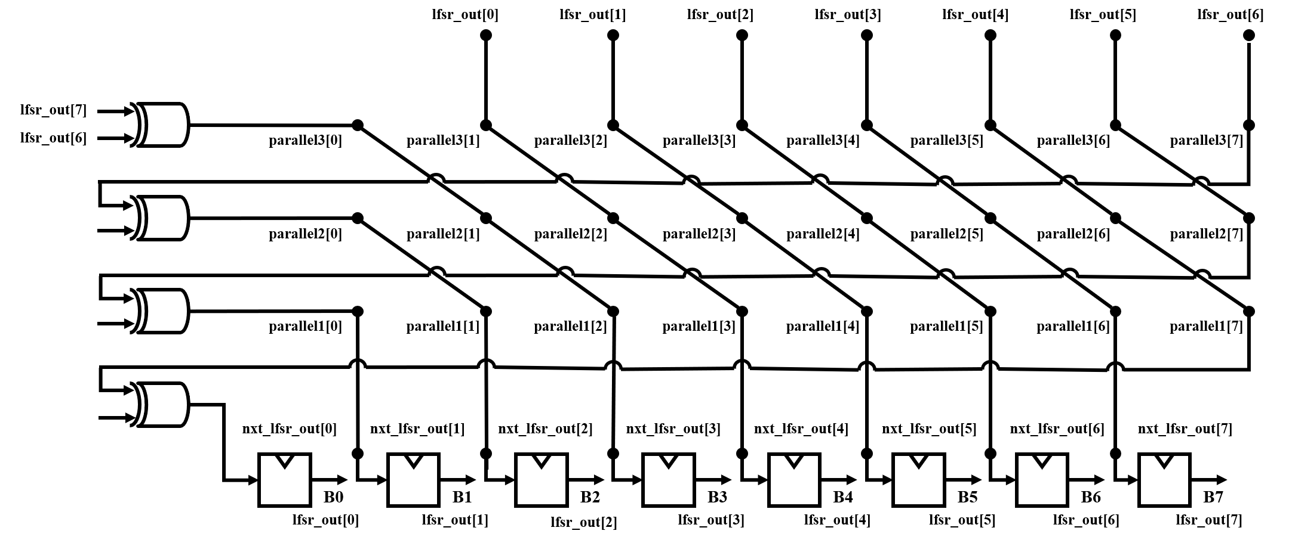
Appendix

Slide 15
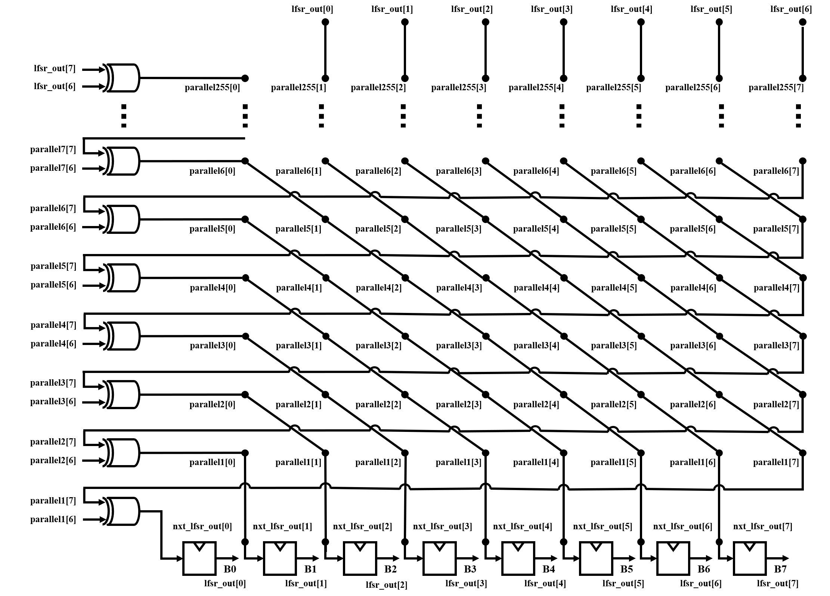
Appendix

